Slide 1
Lending club loan prediction
Predicting Loan Default

Slide 2
Objective
Understand the Lending Club Loan metrics
Identify the significant drivers of loan default
Create classification algorithms to predict loan defaults
Selection of Best Algorithm for classifying loan default

Slide 3
process

Slide 4
Process
Classification Algorithm
Data Inputs
from Universe
Data Exploration
Missing Value Treatment
Conducting Data Experiments
Implementing Classification Algorithms
Model Comparison
Results
Identifying Key Drivers
Performing Data Balancing
Input
Loan Default
Classification
Insights
&
Prediction

Slide 5
Data universe

Slide 6
Data Universe
Credit Information
Loan Information
Personal Information
collection_recovery_fee
collections_12_mths_ex_med
delinq_2yrs
dti
dti_joint
earliest_cr_line
inq_last_6mths
last_credit_pull_d
open_acc
pub_rec
revol_util
total_acc
open_acc_6m
open_il_6m
open_il_12m
open_il_24m
mths_since_rcnt_il
total_bal_il
il_util
open_rv_12m
open_rv_24m
max_bal_bc
all_util
total_rev_hi_lim
inq_fi
total_cu_tl
inq_last_12m
acc_now_delinq
tot_coll_amt
tot_cur_bal
application_type
desc
funded_amnt
funded_amnt_inv
grade
initial_list_status
installment
int_rate
issue_d
last_pymnt_amnt
last_pymnt_d
loan_amnt
loan_status
mths_since_last_delinq
mths_since_last_major_derog
mths_since_last_record
next_pymnt_d
out_prncp
out_prncp_inv
policy_code
purpose
pymnt_plan
recoveries
revol_bal
sub_grade
term
title
total_pymnt
total_pymnt_inv
total_rec_int
total_rec_late_fee
total_rec_prncp
url
verified_status_joint
addr_state
annual_inc
annual_inc_joint
emp_length
emp_title
home_ownership
zip_code
Credit
Information
(30 features)
Loan Information (34 features)
Personal
Information
(7 features)
Data Universe consists of 71 Features

Slide 7
Data exploration

Slide 8
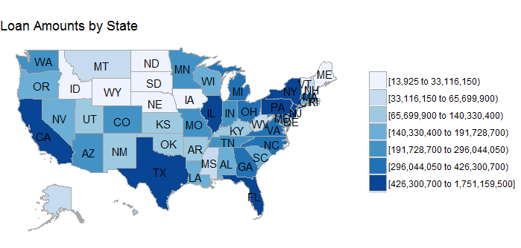
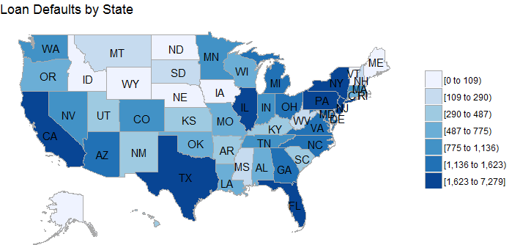
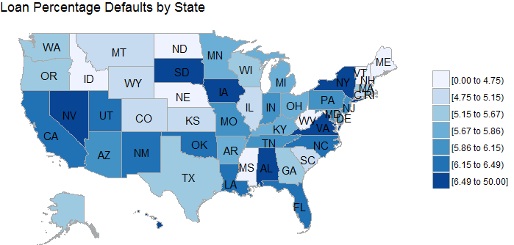


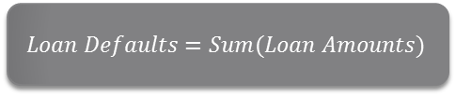
Loan Distributions
$$Loan Defaults=Sum(Loan Amounts)$$
$$Loan Defaults=\# Defaults$$
$$Loan Percentage Default= \frac{\# Defaults}{\#loans}$$

Slide 9
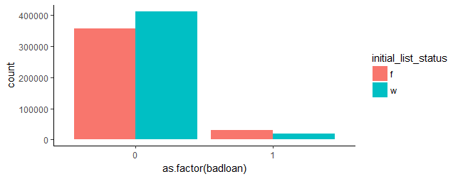
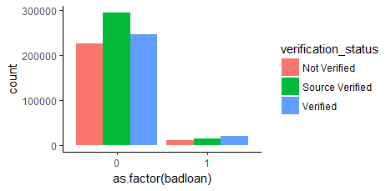
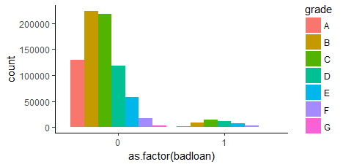
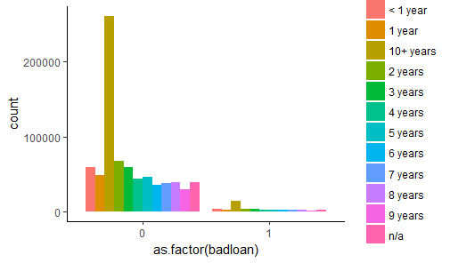
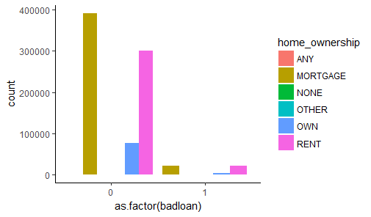
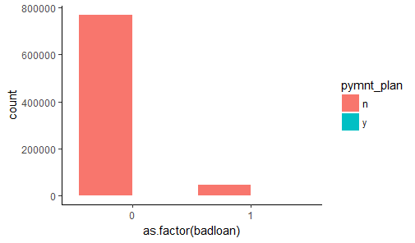
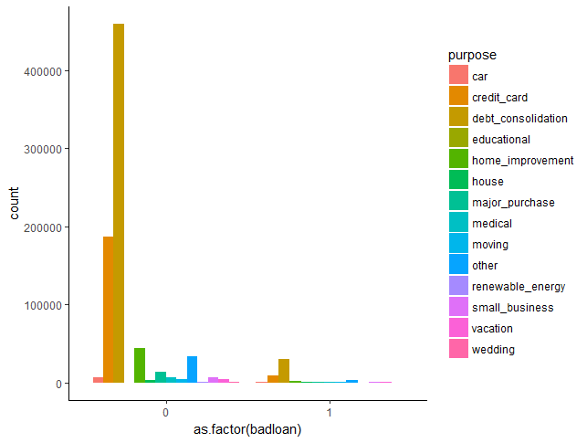







Loan Distributions
$$Verification Status$$
$$Grade$$
$$Employment Length$$
$$Initial List Status$$
$$Home Ownership$$
$$Payment Plan$$
$$Purpose$$

Slide 10
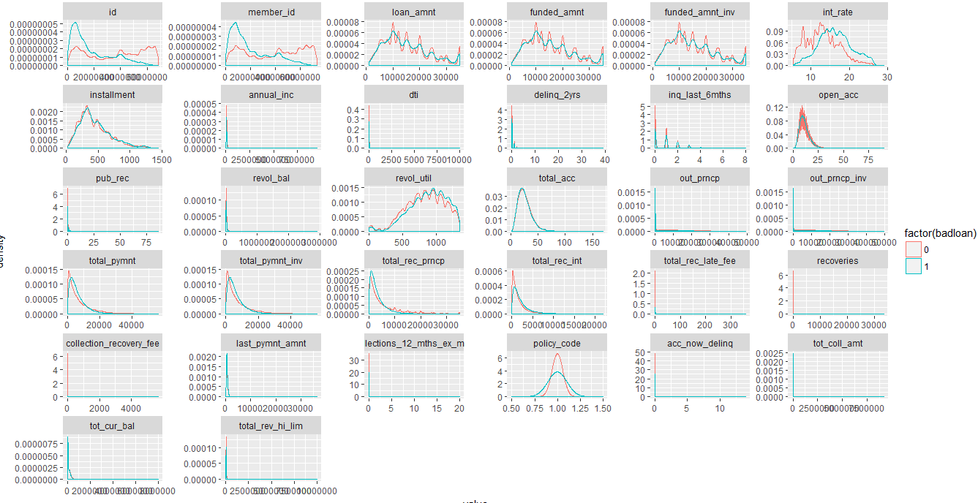
Loan Distributions

Slide 11
DATA EXPERIMENTS

Slide 12
Hypothesis Testing
Significant Numerical Features | Defaulted Loan (Mean) | Not Defaulted Loan (Mean)
loan_amnt | 15,129.9 | 14,989.7
funded_amnt | 15,129.7 | 14,989.7
funded_amnt_inv | 15,123.4 | 14,983.4
int_rate | 16.4 | 13.1
Installment | 460.0 | 442.5
annual_inc | 66,889.7 | 76,096.0
dti | 19.4 | 18.4
inq_last_6mths | 0.9 | 0.7
open_acc | 11.5 | 11.7
pub_rec | 0.2 | 0.2
revol_bal | 15,351.7 | 17,255.0
revol_util | 889.4 | 842.4
total_acc | 24.9 | 25.5
out_prncp | 3,105.5 | 9,477.1
out_prncp_inv | 3,104.3 | 9,473.3
total_pymnt | 6,106.6 | 7,170.5
total_pymnt_inv | 6,103.9 | 7,167.3
total_rec_prncp | 3,252.5 | 5,506.6
total_rec_int | 2,167.3 | 1,663.8
total_rec_late_fee | 2.6 | 0.2
recoveries | 684.3 | -
collection_recovery_fee | 72.8 | -
last_pymnt_amnt | 481.7 | 2,203.5
collections_12_mths_ex_med | 0.0 | 0.0
tot_coll_amt | 156.7 | 230.0
tot_cur_bal | 115,628.4 | 140,941.9
total_rev_hi_lim | 26,559.9 | 32,411.7
SIGNIFICANT VARIABLES
Term
Grade
Sub_Grade
Emp_Length
Home_ownership
Verification_status
Pymnt_plan
Purpose
zip_code
Addr_state
Initial_list_status
application_type
CATEGORICAL (Tested by Chi Square Test)
NUMERICAL (Tested by Welsh T Test)
Categorical Variables are tested using Chi-Square Test
Numerical Variables are tested using Welsh T-Test
Significance in the tests at 5% provides the variables with good classifying strength

Slide 13
Correlation Matrix
KEYWORD | loan_amnt | funded_amnt | funded_amnt_inv | int_rate | installment | annual_inc | dti | delinq_2yrs | inq_last_6mths | open_acc | pub_rec | revol_bal | total_acc | out_prncp | out_prncp_inv | total_pymnt | total_pymnt_inv | total_rec_prncp | total_rec_int | total_rec_late_fee | recoveries | collection_recovery_fee | last_pymnt_amnt | collections_12_mths_ex_med | acc_now_delinq | tot_coll_amt | tot_cur_bal | total_rev_hi_lim | badloan
loan_amnt | 100% | 100% | 100% | 13% | 94% | 33% | 1% | 0% | -3% | 19% | -9% | 34% | 22% | 67% | 67% | 47% | 47% | 38% | 53% | 4% | 7% | 6% | 22% | -2% | 0% | 0% | 33% | 31% | 0%
funded_amnt | 100% | 100% | 100% | 13% | 94% | 33% | 1% | 0% | -3% | 19% | -9% | 34% | 21% | 67% | 67% | 47% | 47% | 38% | 53% | 4% | 7% | 6% | 22% | -2% | 0% | 0% | 33% | 31% | 0%
funded_amnt_inv | 100% | 100% | 100% | 13% | 94% | 33% | 1% | 0% | -3% | 19% | -9% | 34% | 22% | 67% | 67% | 47% | 47% | 38% | 53% | 4% | 7% | 6% | 22% | -2% | 0% | 0% | 33% | 31% | 0%
int_rate | 13% | 13% | 13% | 100% | 11% | -8% | 8% | 5% | 24% | -2% | 5% | -5% | -5% | 3% | 3% | 17% | 17% | 6% | 45% | 6% | 11% | 8% | 10% | 1% | 3% | 0% | -9% | -17% | 17%
installment | 94% | 94% | 94% | 11% | 100% | 33% | 1% | 0% | 1% | 18% | -8% | 32% | 19% | 56% | 56% | 52% | 52% | 45% | 50% | 5% | 7% | 6% | 23% | -2% | 1% | 0% | 30% | 29% | 2%
annual_inc | 33% | 33% | 33% | -8% | 33% | 100% | -9% | 5% | 4% | 13% | -1% | 29% | 18% | 22% | 22% | 16% | 16% | 15% | 13% | 2% | 1% | 1% | 9% | 0% | 1% | 0% | 42% | 27% | -3%
dti | 1% | 1% | 1% | 8% | 1% | -9% | 100% | -1% | 0% | 13% | -3% | 6% | 10% | 4% | 4% | -3% | -3% | -4% | 1% | 0% | 0% | 0% | -3% | 0% | 0% | 0% | -1% | 3% | 1%
delinq_2yrs | 0% | 0% | 0% | 5% | 0% | 5% | -1% | 100% | 3% | 5% | -2% | -3% | 12% | 2% | 2% | -2% | -2% | -3% | 1% | 2% | 0% | 0% | -2% | 6% | 13% | 0% | 6% | -4% | 0%
inq_last_6mths | -3% | -3% | -3% | 24% | 1% | 4% | 0% | 3% | 100% | 13% | 7% | -2% | 15% | -9% | -9% | 8% | 8% | 6% | 9% | 2% | 4% | 3% | 6% | 1% | 0% | 0% | 3% | 1% | 7%
open_acc | 19% | 19% | 19% | -2% | 18% | 13% | 13% | 5% | 13% | 100% | -3% | 22% | 69% | 15% | 15% | 5% | 5% | 4% | 7% | 0% | 0% | 1% | 3% | 1% | 2% | 0% | 24% | 33% | -1%
pub_rec | -9% | -9% | -9% | 5% | -8% | -1% | -3% | -2% | 7% | -3% | 100% | -11% | 1% | -3% | -3% | -8% | -8% | -7% | -6% | -1% | -1% | -1% | -3% | 2% | 0% | 1% | -8% | -10% | -1%
revol_bal | 34% | 34% | 34% | -5% | 32% | 29% | 6% | -3% | -2% | 22% | -11% | 100% | 18% | 24% | 24% | 14% | 14% | 12% | 14% | 0% | 1% | 1% | 6% | -2% | 0% | -1% | 44% | 82% | -2%
total_acc | 22% | 21% | 22% | -5% | 19% | 18% | 10% | 12% | 15% | 69% | 1% | 18% | 100% | 13% | 13% | 12% | 12% | 11% | 9% | 0% | 1% | 1% | 8% | 1% | 3% | 1% | 31% | 26% | -1%
out_prncp | 67% | 67% | 67% | 3% | 56% | 22% | 4% | 2% | -9% | 15% | -3% | 24% | 13% | 100% | 100% | -27% | -27% | -35% | 15% | -2% | -12% | -9% | -35% | 1% | 1% | 0% | 21% | 22% | -18%
out_prncp_inv | 67% | 67% | 67% | 3% | 56% | 22% | 4% | 2% | -9% | 15% | -3% | 24% | 13% | 100% | 100% | -27% | -27% | -35% | 15% | -2% | -12% | -9% | -35% | 1% | 1% | 0% | 21% | 22% | -18%
total_pymnt | 47% | 47% | 47% | 17% | 52% | 16% | -3% | -2% | 8% | 5% | -8% | 14% | 12% | -27% | -27% | 100% | 100% | 97% | 66% | 5% | 3% | 4% | 68% | -4% | -1% | 0% | 17% | 12% | -3%
total_pymnt_inv | 47% | 47% | 47% | 17% | 52% | 16% | -3% | -2% | 8% | 5% | -8% | 14% | 12% | -27% | -27% | 100% | 100% | 97% | 66% | 5% | 3% | 4% | 68% | -4% | -1% | 0% | 17% | 12% | -3%
total_rec_prncp | 38% | 38% | 38% | 6% | 45% | 15% | -4% | -3% | 6% | 4% | -7% | 12% | 11% | -35% | -35% | 97% | 97% | 100% | 46% | 3% | -4% | -2% | 77% | -3% | -1% | 0% | 16% | 12% | -8%
total_rec_int | 53% | 53% | 53% | 45% | 50% | 13% | 1% | 1% | 9% | 7% | -6% | 14% | 9% | 15% | 15% | 66% | 66% | 46% | 100% | 9% | 6% | 5% | 13% | -2% | 0% | 0% | 13% | 7% | 6%
total_rec_late_fee | 4% | 4% | 4% | 6% | 5% | 2% | 0% | 2% | 2% | 0% | -1% | 0% | 0% | -2% | -2% | 5% | 5% | 3% | 9% | 100% | 7% | 6% | -1% | 0% | 0% | 0% | 1% | -1% | 15%
recoveries | 7% | 7% | 7% | 11% | 7% | 1% | 0% | 0% | 4% | 0% | -1% | 1% | 1% | -12% | -12% | 3% | 3% | -4% | 6% | 7% | 100% | 82% | -3% | 0% | 0% | 0% | 0% | 0% | 43%
collection_recovery_fee | 6% | 6% | 6% | 8% | 6% | 1% | 0% | 0% | 3% | 1% | -1% | 1% | 1% | -9% | -9% | 4% | 4% | -2% | 5% | 6% | 82% | 100% | -3% | 0% | 0% | 0% | 1% | 0% | 32%
last_pymnt_amnt | 22% | 22% | 22% | 10% | 23% | 9% | -3% | -2% | 6% | 3% | -3% | 6% | 8% | -35% | -35% | 68% | 68% | 77% | 13% | -1% | -3% | -3% | 100% | -2% | 0% | 0% | 10% | 6% | -8%
collections_12_mths_ex_med | -2% | -2% | -2% | 1% | -2% | 0% | 0% | 6% | 1% | 1% | 2% | -2% | 1% | 1% | 1% | -4% | -4% | -3% | -2% | 0% | 0% | 0% | -2% | 100% | 4% | 1% | -1% | -2% | -1%
acc_now_delinq | 0% | 0% | 0% | 3% | 1% | 1% | 0% | 13% | 0% | 2% | 0% | 0% | 3% | 1% | 1% | -1% | -1% | -1% | 0% | 0% | 0% | 0% | 0% | 4% | 100% | 0% | 2% | 1% | 0%
tot_coll_amt | 0% | 0% | 0% | 0% | 0% | 0% | 0% | 0% | 0% | 0% | 1% | -1% | 1% | 0% | 0% | 0% | 0% | 0% | 0% | 0% | 0% | 0% | 0% | 1% | 0% | 100% | 0% | -1% | 0%
tot_cur_bal | 33% | 33% | 33% | -9% | 30% | 42% | -1% | 6% | 3% | 24% | -8% | 44% | 31% | 21% | 21% | 17% | 17% | 16% | 13% | 1% | 0% | 1% | 10% | -1% | 2% | 0% | 100% | 38% | -4%
total_rev_hi_lim | 31% | 31% | 31% | -17% | 29% | 27% | 3% | -4% | 1% | 33% | -10% | 82% | 26% | 22% | 22% | 12% | 12% | 12% | 7% | -1% | 0% | 0% | 6% | -2% | 1% | -1% | 38% | 100% | -4%
badloan | 0% | 0% | 0% | 17% | 2% | -3% | 1% | 0% | 7% | -1% | -1% | -2% | -1% | -18% | -18% | -3% | -3% | -8% | 6% | 15% | 43% | 32% | -8% | -1% | 0% | 0% | -4% | -4% | 100%

Slide 14
Classification Model

Slide 15
Classification Model
1: 5.84%
0 : 94.15%
1: 49.99%
0 : 50.01%
Loan Dataset with significant variables
Train
(70% data)
Balancing of data
(ROSE)
Logistic Regression
Logit Model
Low Variance
Random Forest
Ensemble Method
Low Variance
Decision Trees
Rpart Tree
High Variance
Low Bias
Low Bias
High Bias
Gradient Boosting
Boosting Ensemble
Low Variance
Low Bias
Test
(30% data)

Slide 16
MODEL EVALUATION & SELECTION
Results captured on the test dataset

Slide 17
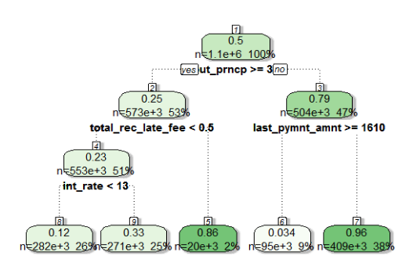
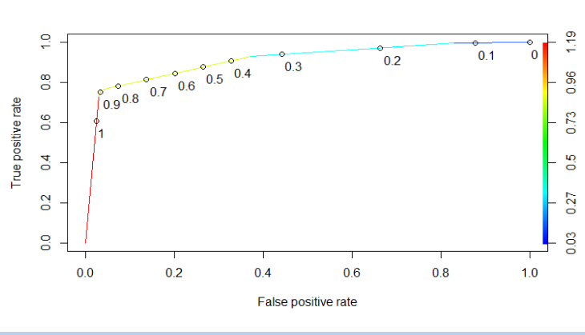
Decision Trees
Decision Tree
ROC Curve (with AUC Value)
AUC - 0.9085706
Confusion Matrix
Key Metrics
Predicted
Metric | Value
Accuracy | 95.60%
Precision | 60.63%
Recall | 72.60%
0 | 1
0
1
223,885 | 6,807
3,956 | 10,484
Actual

Slide 18
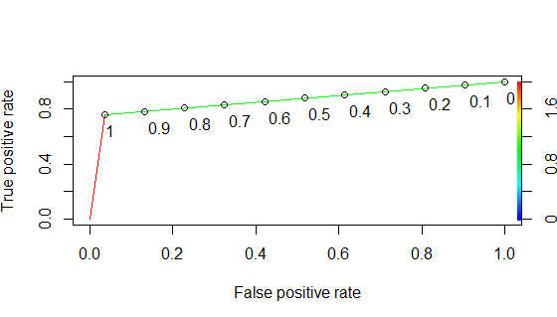
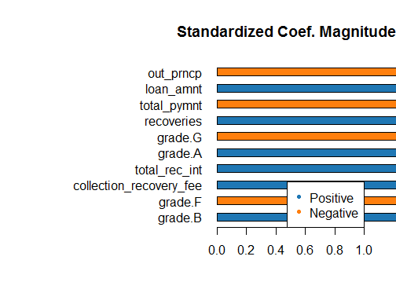
Logistic Regression
ROC Curve (with AUC Value)
AUC - 0.8758
Confusion Matrix
Key Metrics
Predicted
Metric | Value
Accuracy | 92.91%
Precision | 44.34%
Recall | 81.55%
0 | 1
0
1
216,040 | 14,714
2,652 | 11,726
Actual

Slide 19
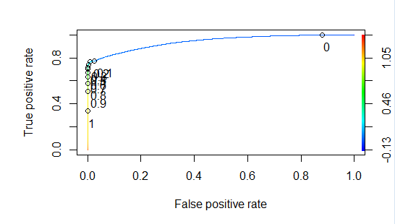
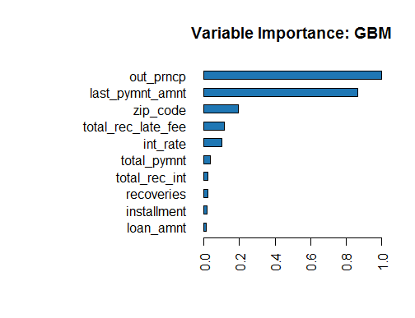
Gradient Boosting
ROC Curve (with AUC Value)
AUC - 0.9293
Confusion Matrix
Key Metrics
Predicted
Metric | Value
Accuracy | 98.06%
Precision | 98.75%
Recall | 67.91%
0 | 1
0
1
230,631 | 123
4,614 | 9,764
Actual

Slide 20
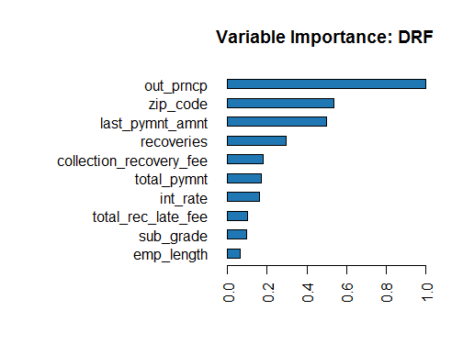
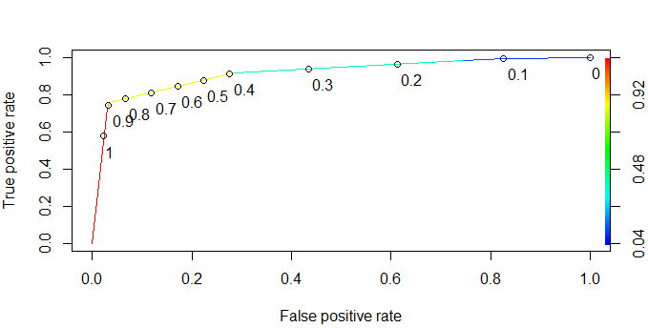
Random Forest
ROC Curve (with AUC Value)
AUC – 0.9304
Confusion Matrix
Key Metrics
Predicted
Metric | Value
Accuracy | 98.27%
Precision | 98.95%
Recall | 70.75%
0 | 1
0
1
230,647 | 107
4,206 | 10,172
Actual

Slide 21
ACTIONABLE INSIGHTS

Slide 22
Insights
The Random Forest Algorithm works best because :
It has a high Area under the curve (AUC)
The Precision from the Random Forest Algorithm is high on the testing set (We want high precision as we want to identify the default applicants accurately)
Therefore, we are able to accurately predict the loan default with a precision of ~97.5%
~75% of the loan defaults are predicted by the random forest model
Zip Code, Interest Rate and Employment Length are among the top 10 significant features for categorizing the loan applicant. This Personal Information helps in weeding out unnecessary loan applications at the initial phase of the loan process
Outstanding Principal Amount, Recoveries and Last Total Payment Amounts are among the top 10 Loan Information to determine whether the loan would default or not. The Loan Information would help categorizing the loans earlier itself.
Collection Recovery Fee, Grade and Sub Grade are important variables in determining whether the loan would default or not. Grade and Sub Grade are in-house Lending Club categories that aid in showing riskiness of the Loan.

Slide 23
Appendix

Slide 24
Appendix
Please find additional documents for this analysis attached below :
File | Attachment
Data Dictionary
Features Summary Statistics
Code for the full analysis

